Slide 1
Advantages of utilizing the CWT HEATER SYSTEM
IN VERTICAL HEATER TREATER APPLICATIONS
In-Direct Steam Heat in Light Oil Process Applications
A technology

Slide 2
ADVANTAGES OF UTILIZING THE CWT HEATER SYSTEM
IN VERTICAL HEATER TREATER APPLICATIONS
Technology was discovered in 2000 – 2001
Heavy oil application field testing
Units are still in service today
Natural gas line heaters went into service in 2004 and are still today
Very successful product line across North America
Used in heating light oil tanks for process
Approximately 180 in use in Saskatchewan and 25 in North Dakota
In those regions we have permission to use CWT heaters to heat light oil in a tank
Received permission in Saskatchewan in 2010 from Sask Energy and Mines

Slide 3
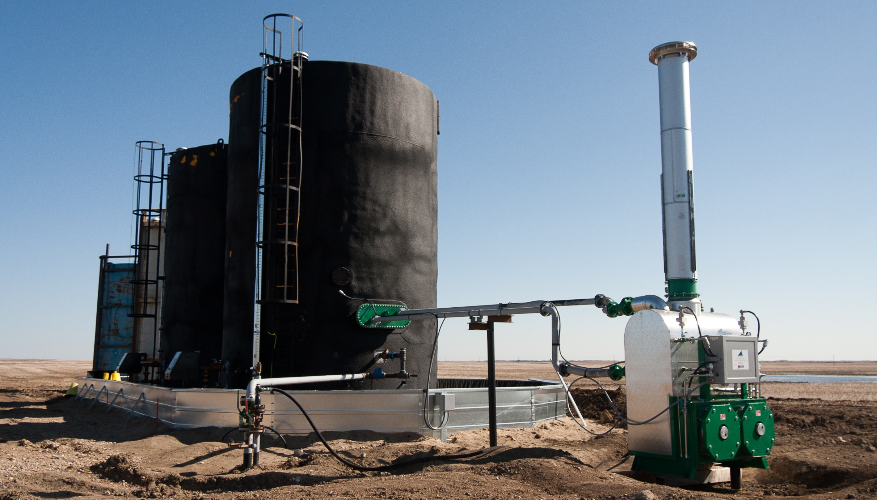
Operates on 26 psig vacuum to 250 degrees F
Certified Non-incendive electrical control system
Operates 21 feet from tank in general purpose area
Reduces emissions and fuel gas consumptions by up to 50 per cent
Operates at 75 to 80 per cent thermal efficiency
No electricity required
No special boiler certifications to operate in class one zone two hazardarous location
System as a whole is currently being recertified
Due to issues with CSA, an alternate certifying body is currently completing the re-certification
COLD WEATHER TECHNOLOGIES (CWT)
HAS A STRONG HISTORY OF
HEATING FLAMMABLE LIQUIDS &
NATURAL GAS
Safe, Silent, Long Life
No moving parts like motors, pumps, floats
Silent operation
Low pressure (2 oz) utility or well head gas supply
Flame arrested air intake built to US Coast Guard standard
ASME Section IV vacuum boiler design

Slide 4
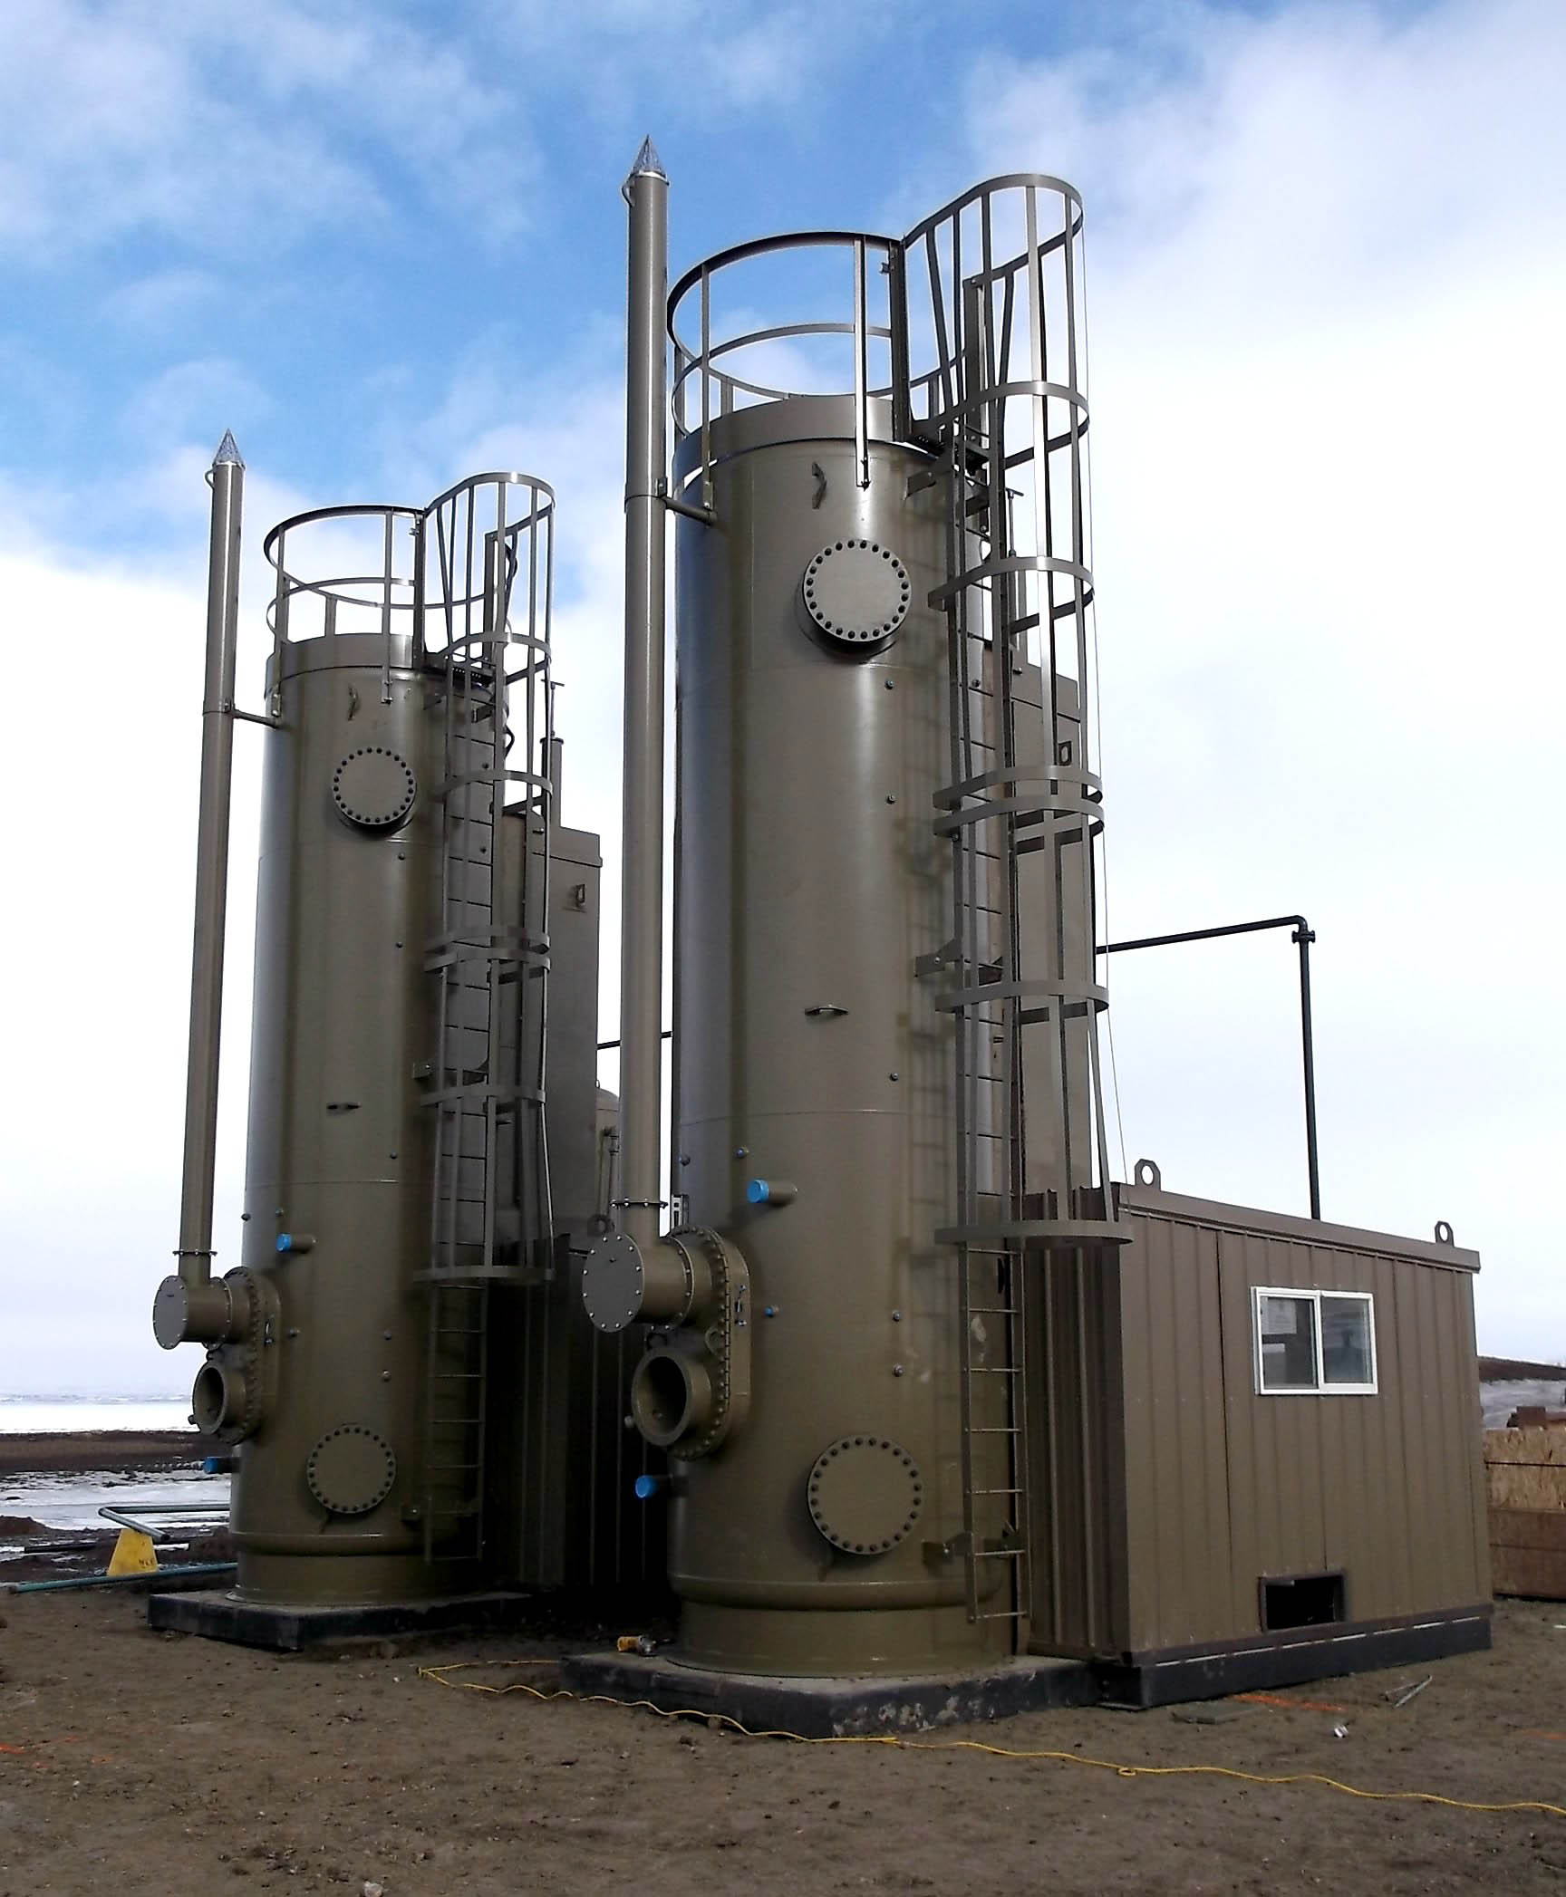
CHALLENGES IN INDUSTRY TO ACHIEVE SAFETY AND ENVIRONMENTAL COMPLIANCE: Fire Tubes Changing Rail Transport Standards
Fire tubes cannot be used to heat oil in a tank for processing purposes
Fire tubes use pounds of gas pressure
High skin temperature make fire tubes unsafe for heating flammable liquids
High skin temperature beyond coating specs
Fire tubes will eventually fail into costly, and sometimes catastrophic, events.
Fire tubes are proven to be 40 to 45 per cent efficient.
Rail transport issues
Need to heat all oil to minimum 110 F
Requires a 13.7 RVP test prior to loading
Fire tubes are having a high failure rate trying to achieve new standards

Slide 5
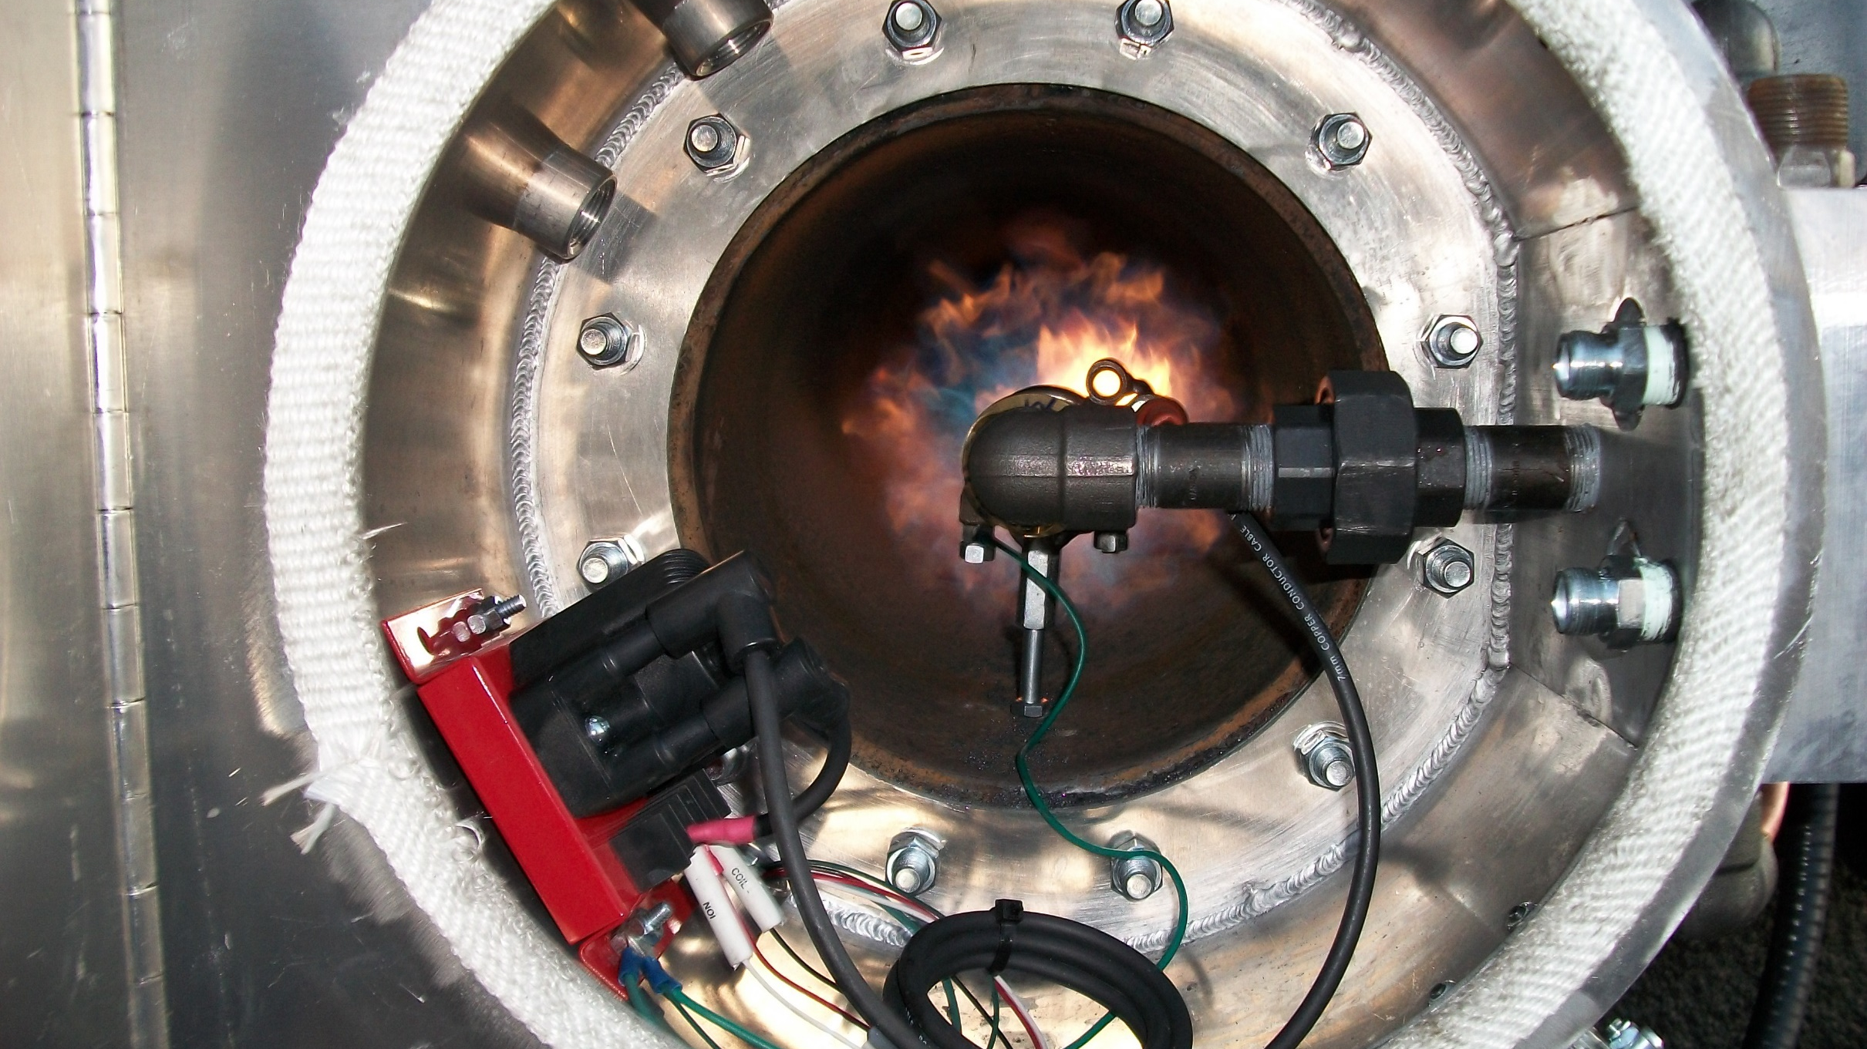
Very simplistic technology
Becomes more complex when BMS is utilized
Contributes heavily to greenhouse gas emissions
Heavy fuel gas consumption if using propane
Safety and environmental concerns
CHALLENGES WITH
FIRE TUBE HEATING TECHNOLOGY
IN MODERN APPLICATIONS

Slide 6
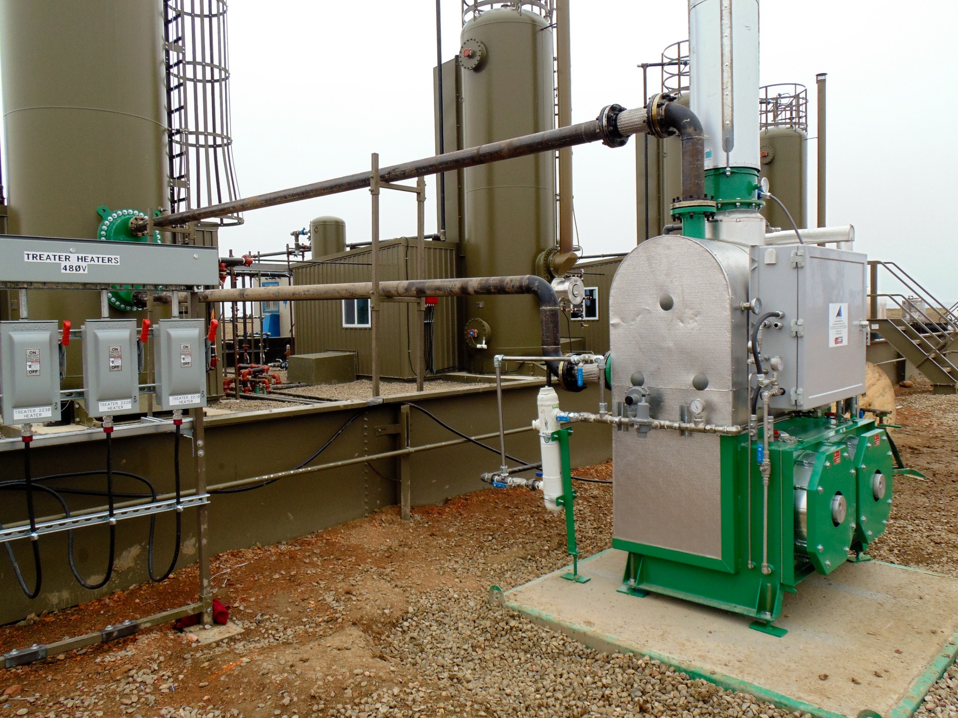
NEW TECHNOLOGY IN CLOSED LOOP IN-DIRECT STEAM HEAT: - No make up water required for system - Uses latent heat transfer into process - Steam temperatures well within coating spec - Heat exchanger same bolt pattern as fire tube - Oil level lowered in Vertical Heater Treater so oil is heated, and not the water - Heat exchanger is immersed in oil - Volumetrics: 6’ CWT VHT Exchanger is 110 sq ft – 40.8 gallons displacement 16” Fire Tube is 53 sq ft – 132 gallons displacement 8’ CWT VHT Exchanger is 148 sq ft – 55 gallons displacement 16” Fire Tube is 70 sq ft – 174 gallons displacement

Slide 7
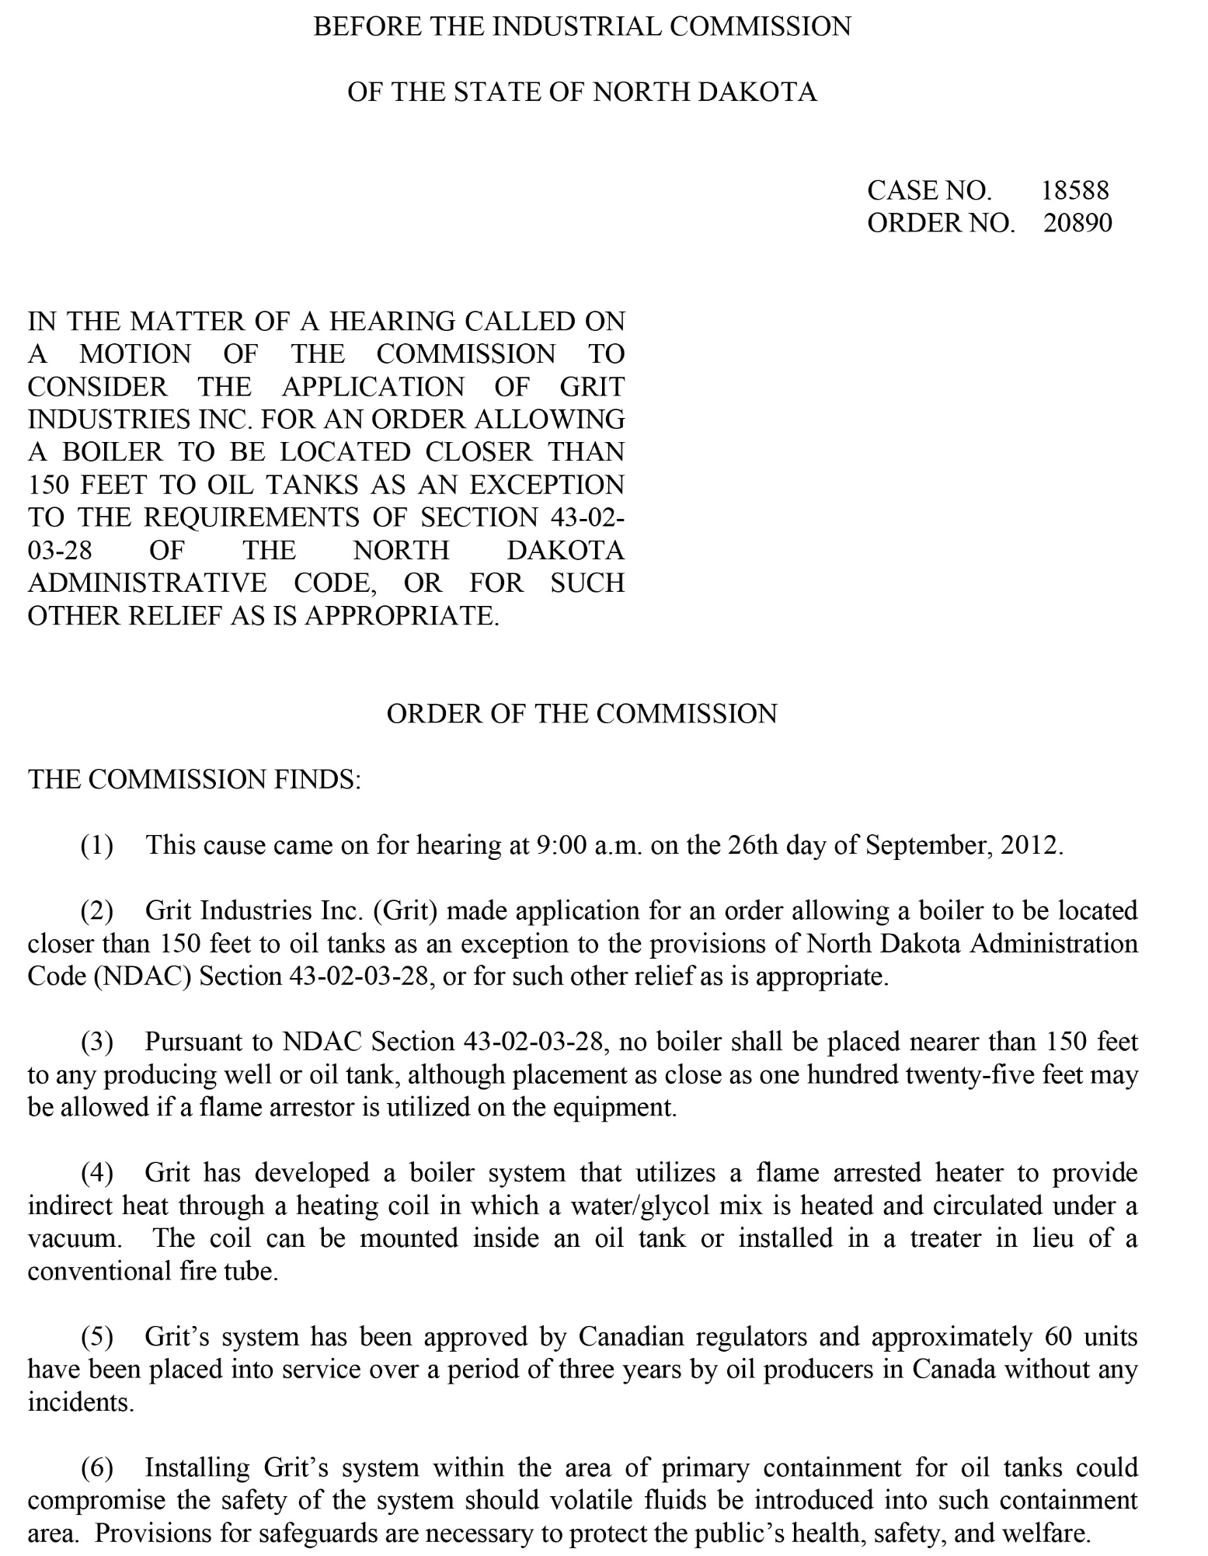
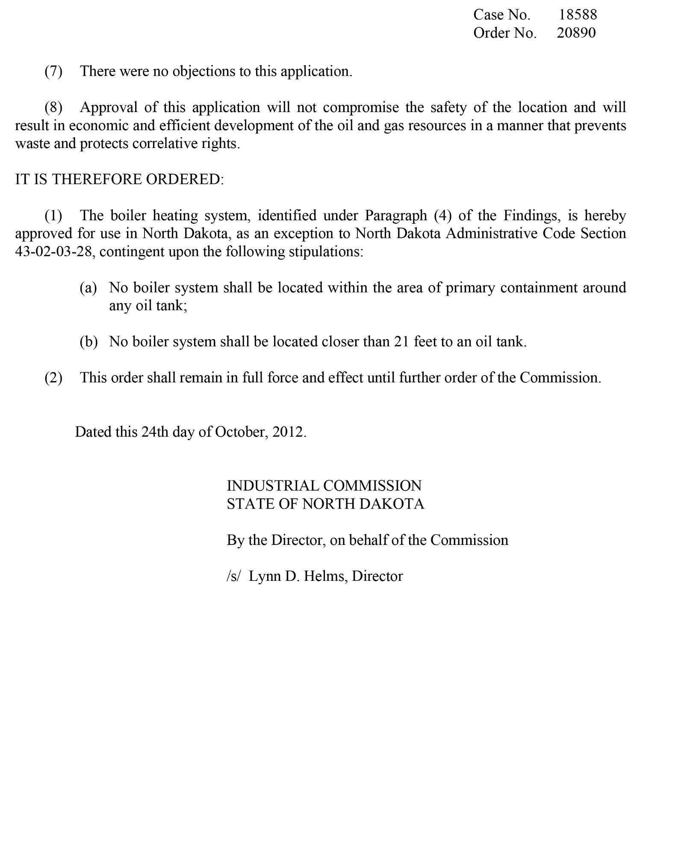
NORTH DAKOTA LETTER

Slide 8
NORTH DAKOTA INDUSTRIAL COMMISSION REVIEW AND ORDER
October 24, 2012 NDIC grants similar approvals that are standard in Saskatchewan
21 feet away from tank rather than 125 feet from tank as is currently standard in ND
Very significant ruling for future activities
Outside of secondary containment in General Purpose location
Allows for direct heating of oil tanks with low gas production (GOR)

Slide 9
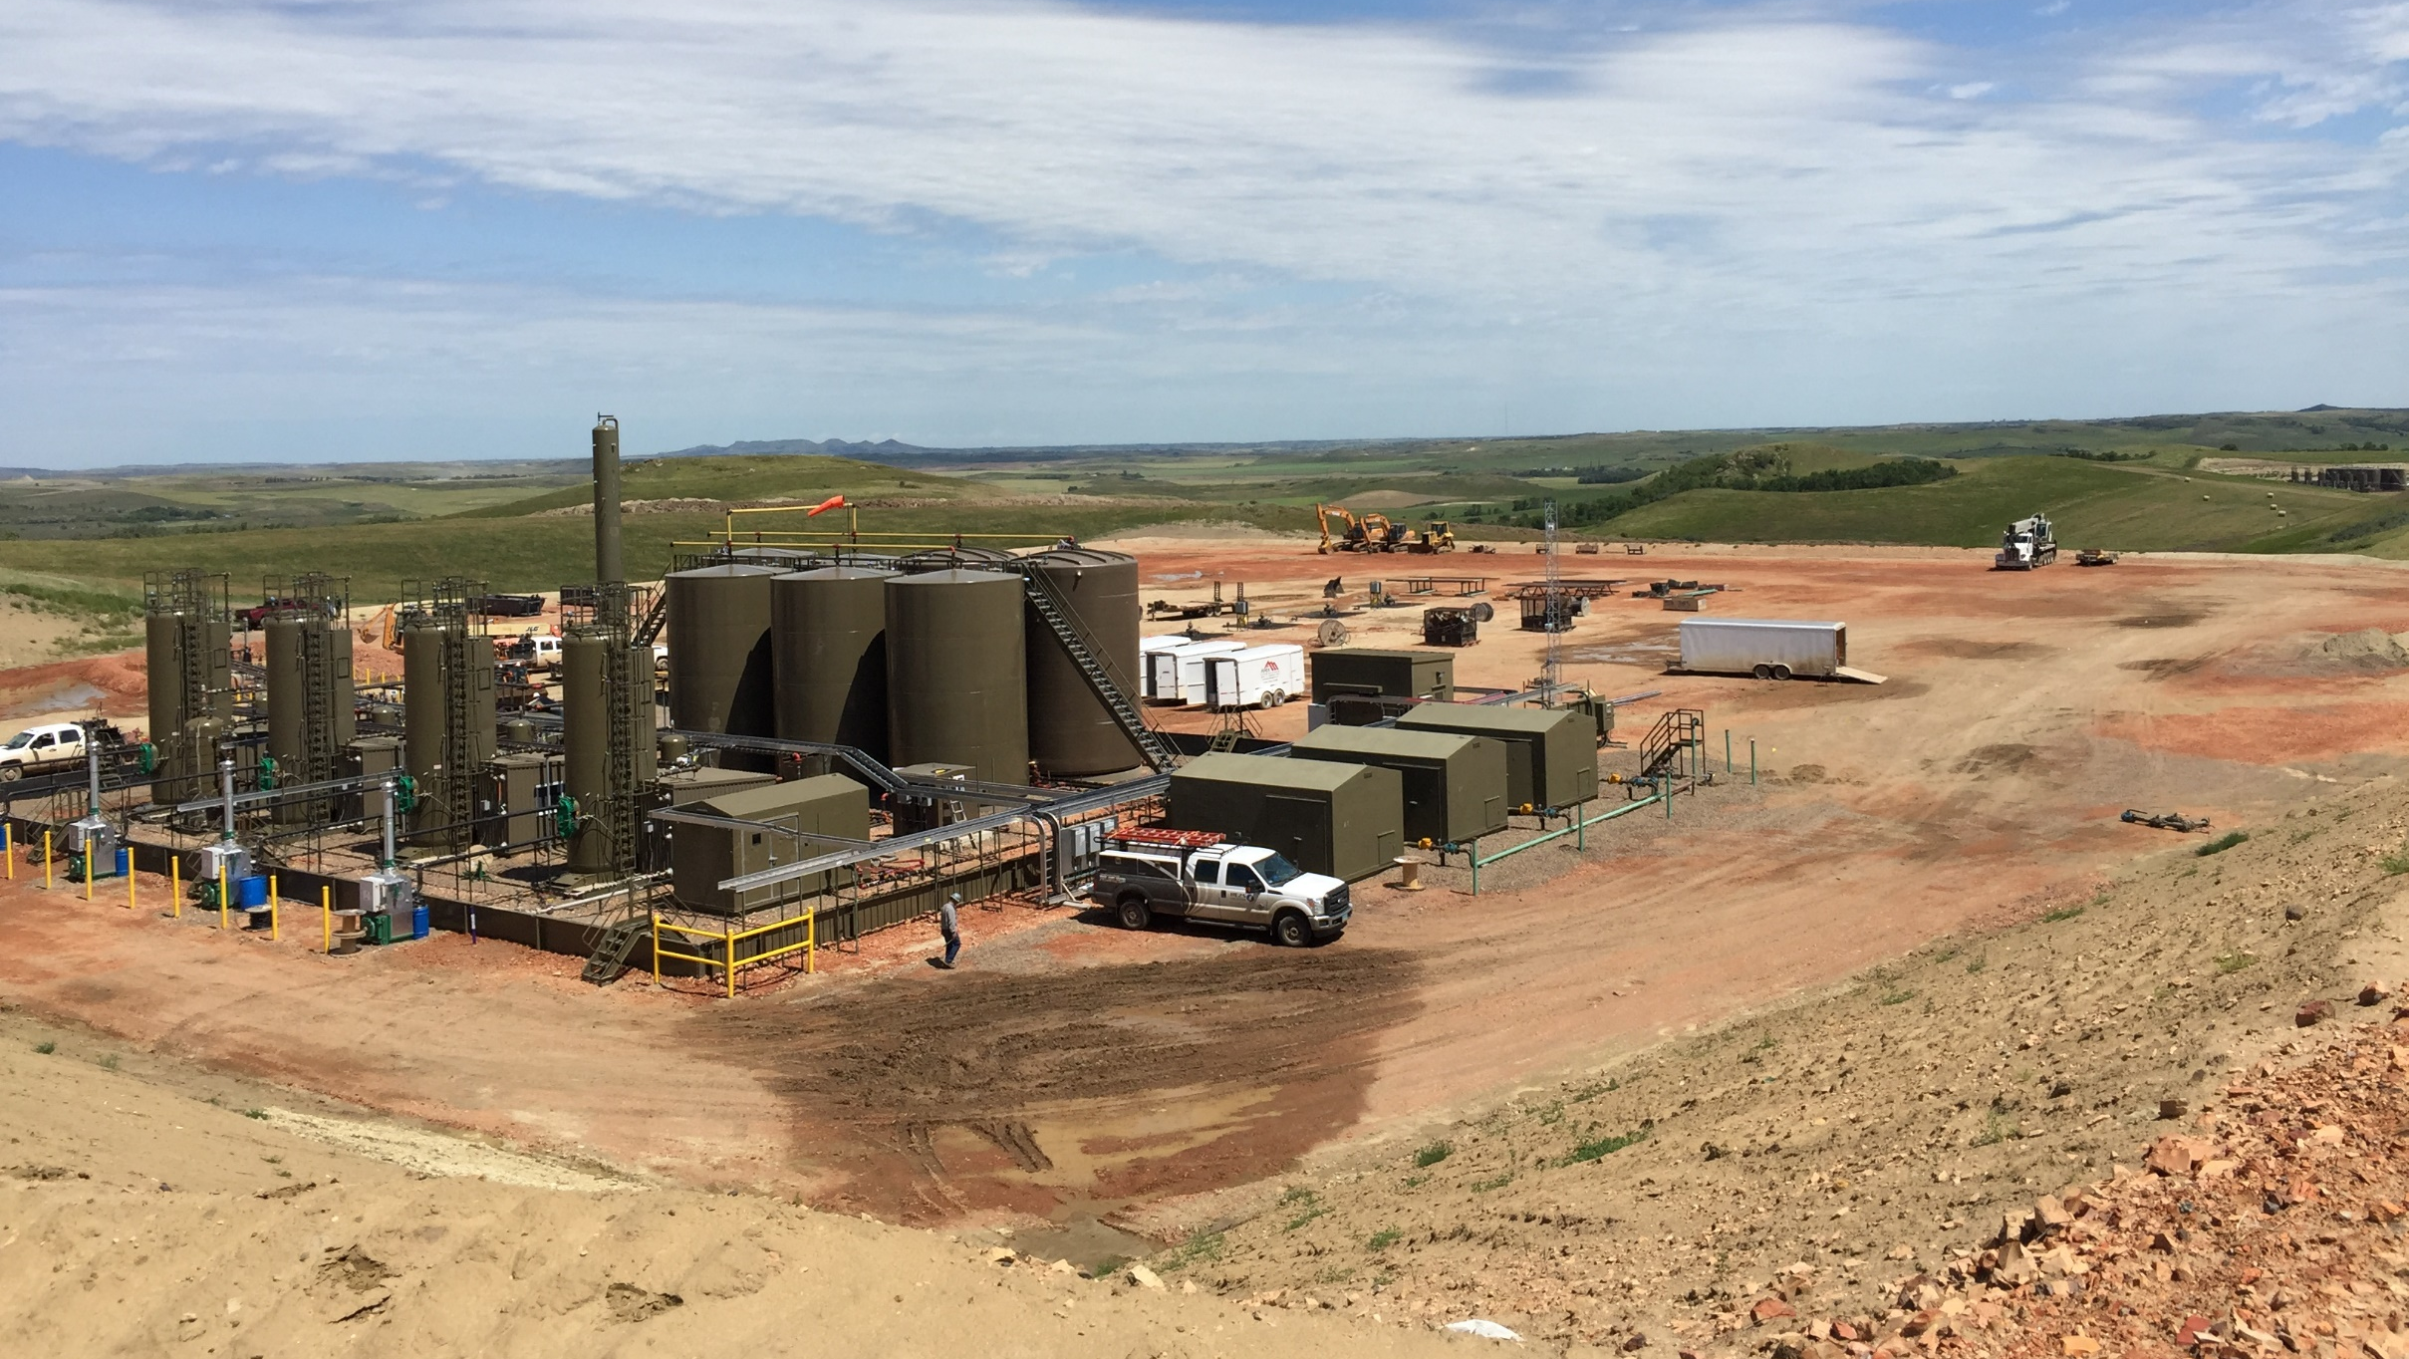
Much smaller lease – save costs of:
Raw land purchase
Clearing, gravelling, plowing
Annual fees
Production equipment cost savings
Less piping, insulating
Smaller containment
Longevity of process heating equipment
45 to 50 year boiler life
15 to 20 year heat exchanger life
Eliminate fire tube replacements
Lost production
Replacement components
Crew time
Transportation costs
Disposal fees
Spills
Lost time of manpower
SIGNIFICANT COST SAVINGS IN
ALL AREAS OF LEASE OPERATIONS

Slide 10
THANK YOU

